Slide 1

ARC 523 Modeling-1 Target building : Office in a factory
Seungmin Lee
09.05.2023
College of Design

Slide 2
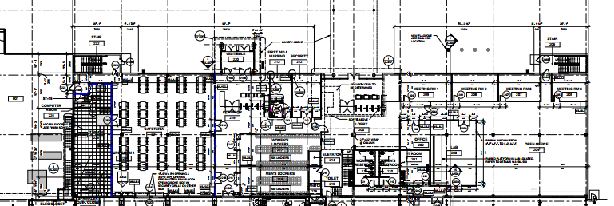
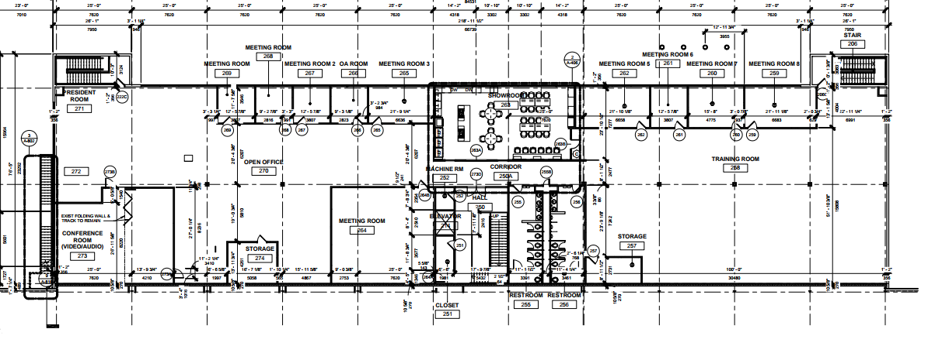
Floor Plan
Figure 1. Floor 1 of the target building
Figure 2. Floor 2 of the target building

Slide 3
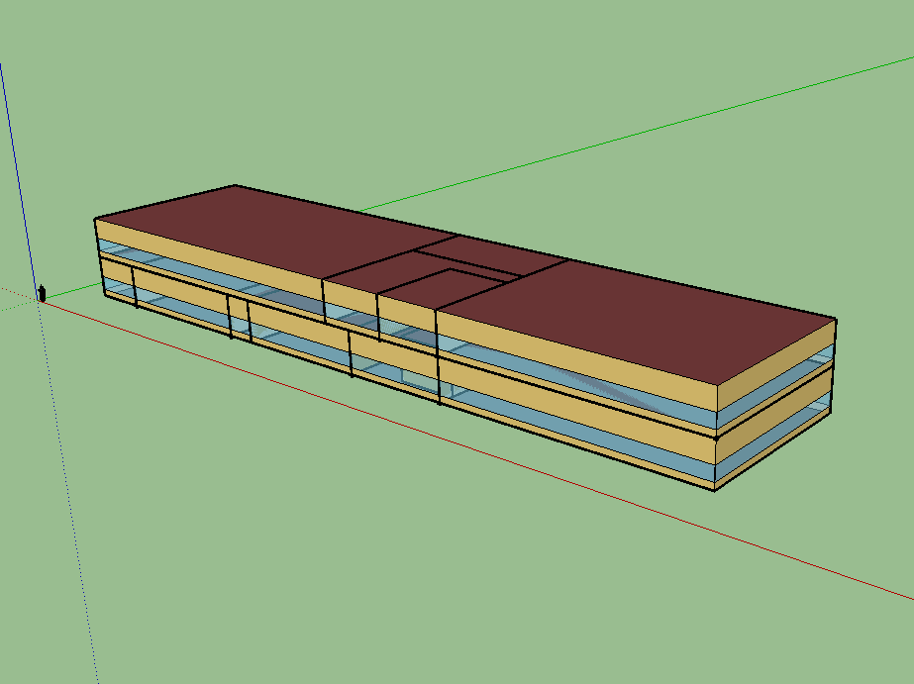
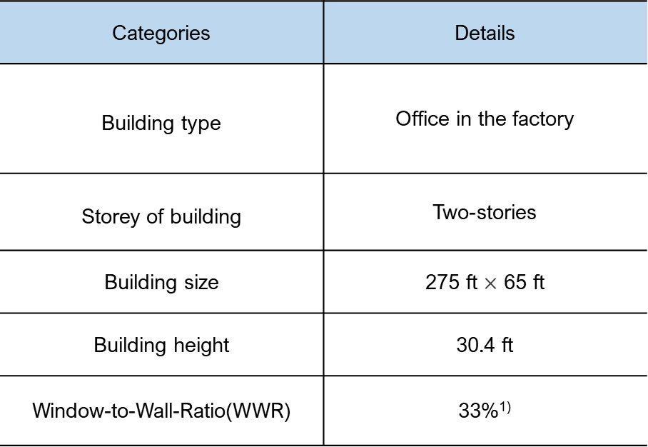
Characteristics
Categories | Details
Building type | Office in the factory
Storey of building | Two-stories
Building size | 275 ft $×$ 65 ft
Building height | 30.4 ft
Window-to-Wall-Ratio(WWR) | 33%¹⁾
Figure 3. Modeling of the target building
1) 2003 CBECS Data and PNNL's CBECS Study 2007

